Slide 1
Accessible Tables
Michael Molina

Slide 2
Topics Covered
1. Table Accessibility Standards
2. Table Accessibility Terminology
3. OTL Checkpoints for Tables
4. How to Ensure Table is Accessible in Adobe PDF

Slide 3
1. Table Accessibility Standards
OTL table accessibility follows Web Content Accessibility Guidelines (WCAG) 2.1 as well as Section 508 of the Rehabilitation Act of 1972, as amended by the Oklahoma Electronic Information Technology Accessibility (EITA) Act.
https://www.w3.org/TR/WCAG21/
https://www.ok.gov/accessibility/
Does your state have any specific laws relating to electronic accessibility?

Slide 4
2. Table Accessibility Terminology
Header Cell and Table Data Cell
Vehicle (Header Cell) | Number (Header Cell)
Car (Table Data Cell) | 5 (Table Data Cell)
Truck (Table Data Cell) | 2 (Table Data Cell)
SUV (Table Data Cell) | 45 (Table Data Cell)

Slide 5
2. Table Accessibility Terminology
Simple data table: A table with just one header row
Complex data table: A table with multiple header rows and/or merged cells
Class | Teacher
Fundamentals of Librarianship | John Doe
Fundamentals of Librarianship | Jane Doe
Class | Teacher
Fundamentals of Librarianship | John Doe
 | Jane Doe

Slide 6
2. Table Accessibility Terminology
Other types of complex tables (irregular/multilevel headers)
Staff | Employee Classification
 | A1 | A2 | A3 | A4
Volunteers | Jane Doe | John Doe | Bob Doe | Jill Doe
 | Jimmy Doe | Jamie Doe | Jolene Doe | Jeb Doe
 | Janice Doe | Jerry Doe | Jack Doe | Jade Doe
 | Joel Doe | Jocelyn Doe | Justice Doe | Janet Doe

Slide 7
3. OTL Checkpoints for Tables
1. Table header rows are programmatically identified
2. Tables with header cells mixed with data cells and/or more than one row of column headers or more than one column of row headers have a table summary in the table alt text attribute that explains the table structure
3. Data tables are in a table format, not an image of a table
4. Tables used to position content are arranged so that top to bottom, left to right reading order is preserved
5. Tables do not have merged cells
6. Tables have no more than one row of column headers and column of row headers
7. Tables Headings go outside the table
8. Tables do not have header cells mixed with data cells

Slide 8
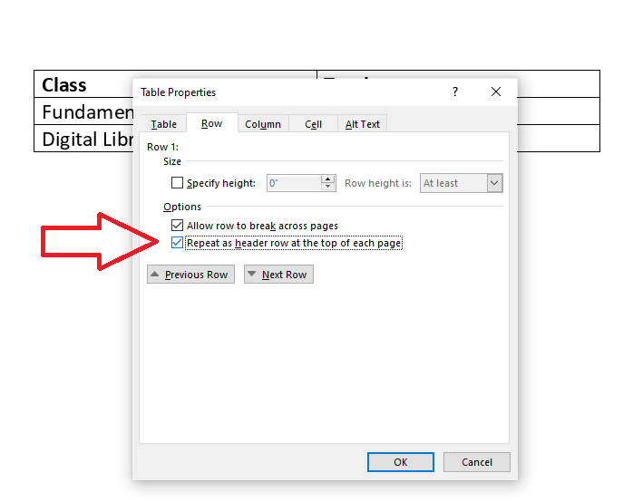
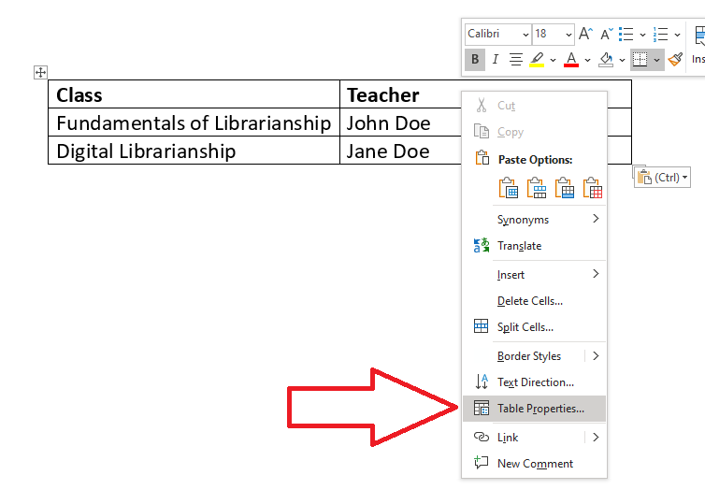
3.1 Table Header Rows
To ensure that the row of header cells is identified, you must right click the header row and select “Table Properties.” Select the “Row” tab, and check the box labeled “Repeat as header row at the top of each page.”

Slide 9
3.1 Table Header Rows Cont.
Example of repeated header row
Example of non-repeated header row

Slide 10
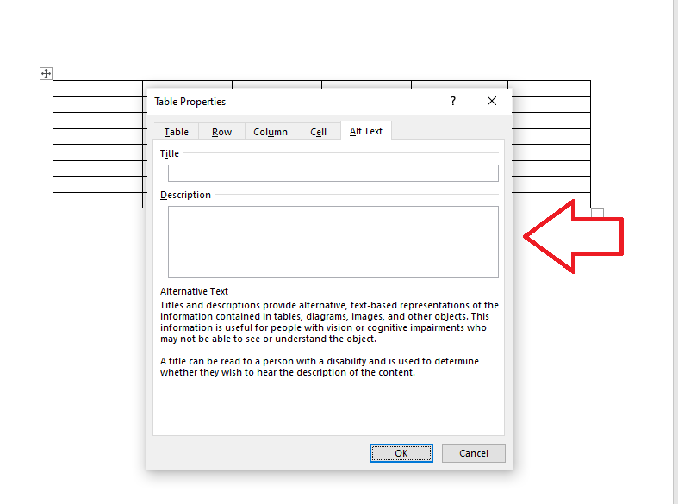
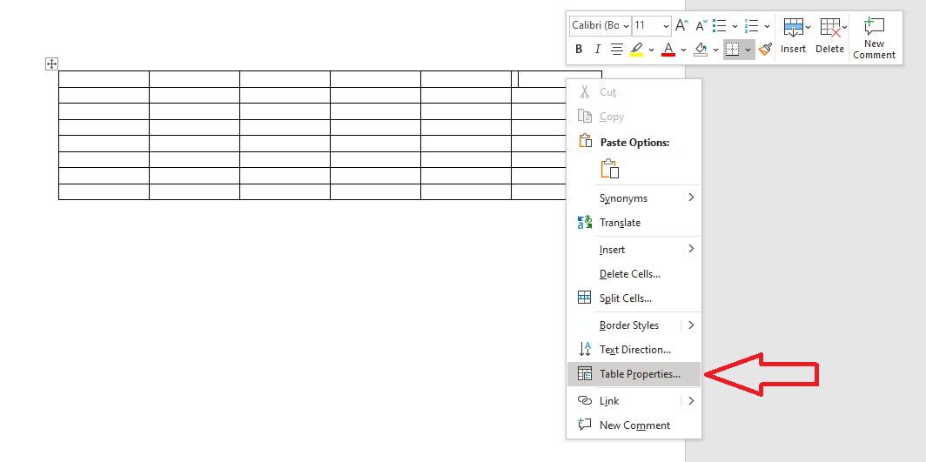
3.2 Table Summaries
Tables with header cells mixed with data cells and/or more than one row of column headers or more than one column of row headers can have a table summary in the table alt text attribute that explains the table structure. To add alt text to a table, right click on the table and select Table Properties. Type the description into the Description field of the Alternative Text menu.

Slide 11
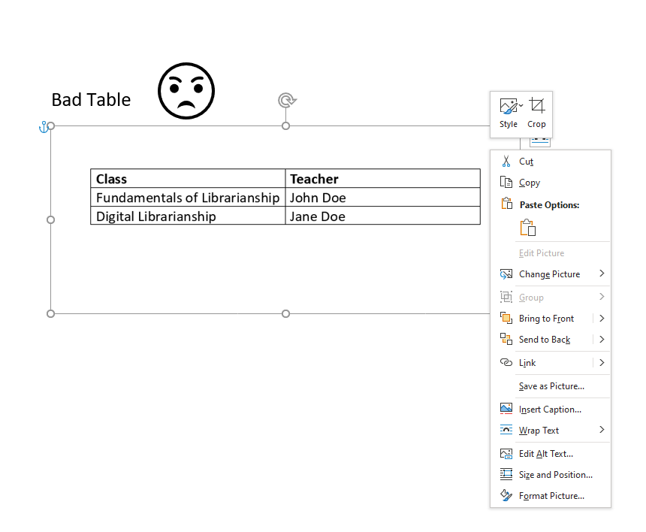
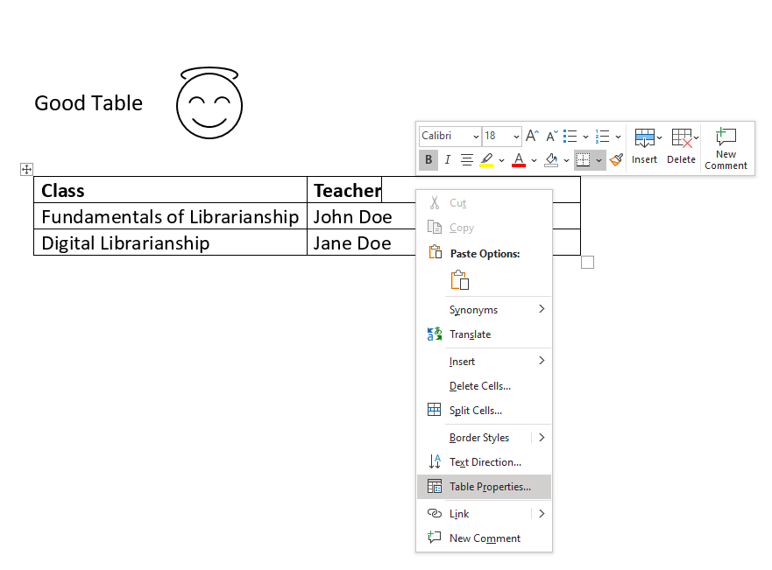
3.3 Tables Must Be Constructed, Not Image of a Table

Slide 12
3.4 Left to Right Reading Order is Preserved
Assistive technologies and screen reading software will read a table from top to bottom, left to right. Be sure that the intended reading order still makes sense when you read the table across one row from left to right, then down to the next row and left to right, and so on. This reading order can be thrown off if your table contains split cells or merged cells. If the reading order does not match what you intend, then move your content into different cells so that it is in a logical reading order for everyone.

Slide 13
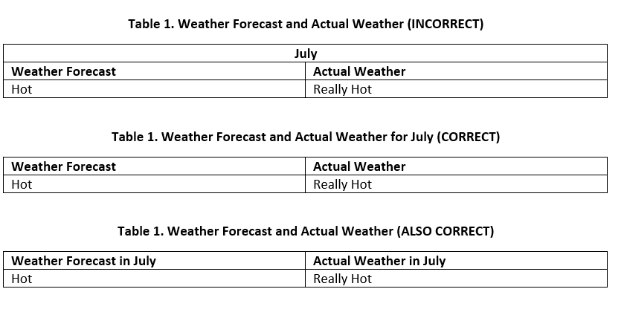
3.5 Tables Do Not Have Merged Cells
It is best practice to build simple tables. Avoid merging cells by moving text in merged cells into captions or including the information in other cells. Below is an example of a merged cells and two possible ways to remediate the table.

Slide 14
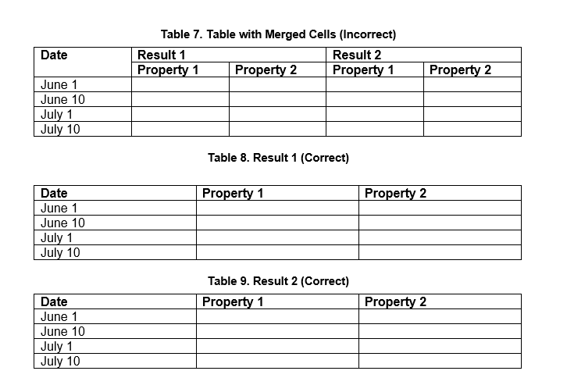
3.5.1 More Fun With Merged Cells

Slide 15
3.5.2 More Fun With Merged Cells Cont.

Slide 16
3.6 Column Headers and Column Rows
Tables should have no more than one row of column headers and one column of row headers.

Slide 17
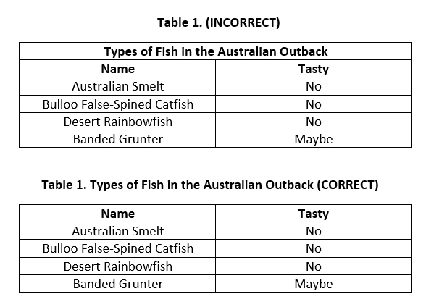
3.7 Table Headings Go Outside the Table
Place a general table heading into the document as text formatted as a Word Heading Style or use the table caption to label the table.

Slide 18
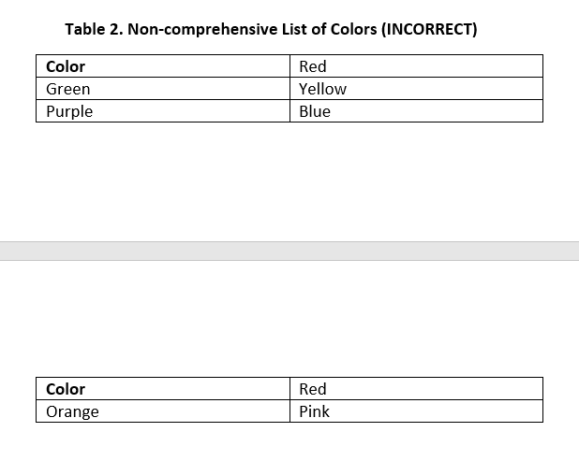
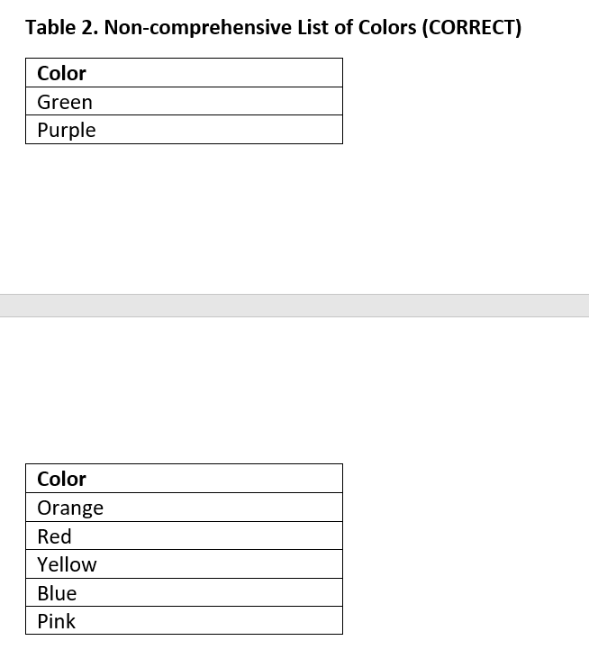
3.8 Tables Do Not Have Header Cells Mixed With Data Cells
Including header cells among data cells in a table makes the table more difficult to follow. If possible, it is easier to consolidate the table to improve readability.

Slide 19
4. Accessible Tables in Adobe PDF
The good, the bad, and the ugly

Slide 20
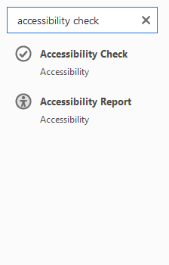
Checking Your Table with the Accessibility Checker
Convert your Word Document to PDF.
Open PDF and type in Accessibility Check in the search bar to bring up the Accessibility Check. This can also be found under the accessibility section in Adobe Acrobat or Adobe DC.
The checker will check to make sure that the table is properly tagged. This includes rows, TH (table header) and TD (table data), headers, regularity, and summary.
Regularity: This checks to see if the table contain the same number of columns in each row, and rows in each column.
Summary: Table summaries are optional but can improve accessibility.

Slide 21
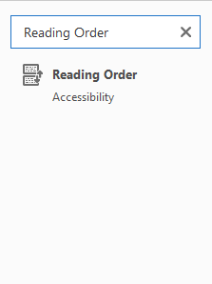
Checking Your Table Manually (Recommended)
Type in Reading Order in search bar and select. This can also be found under the accessibility section in Adobe Acrobat or Adobe DC.

Slide 22
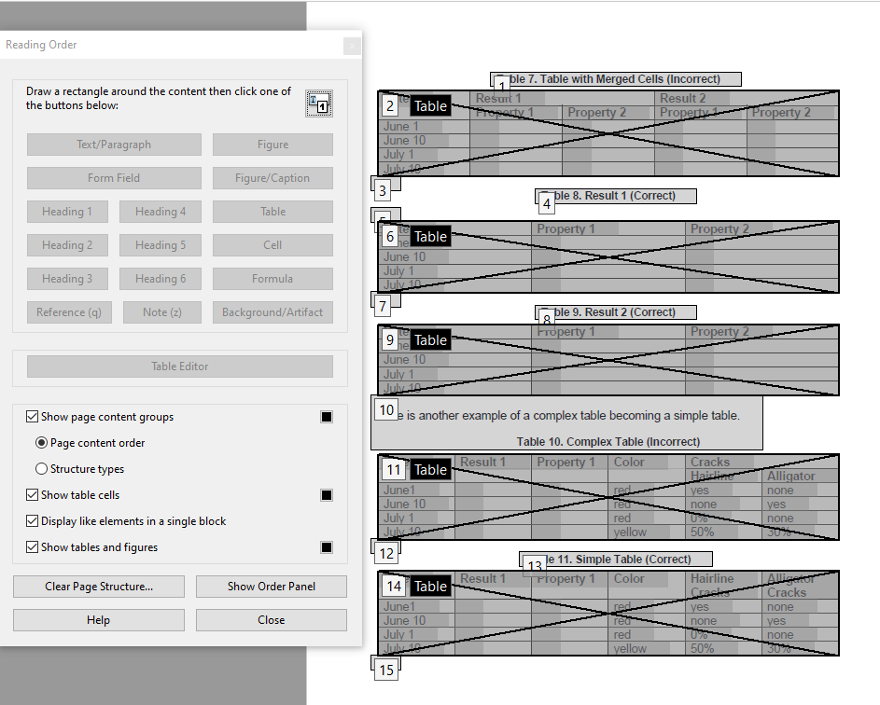
The Reading Order tool will come up showing the numbered order on the page.
Uncheck “Display like elements in a single block.”

Slide 23
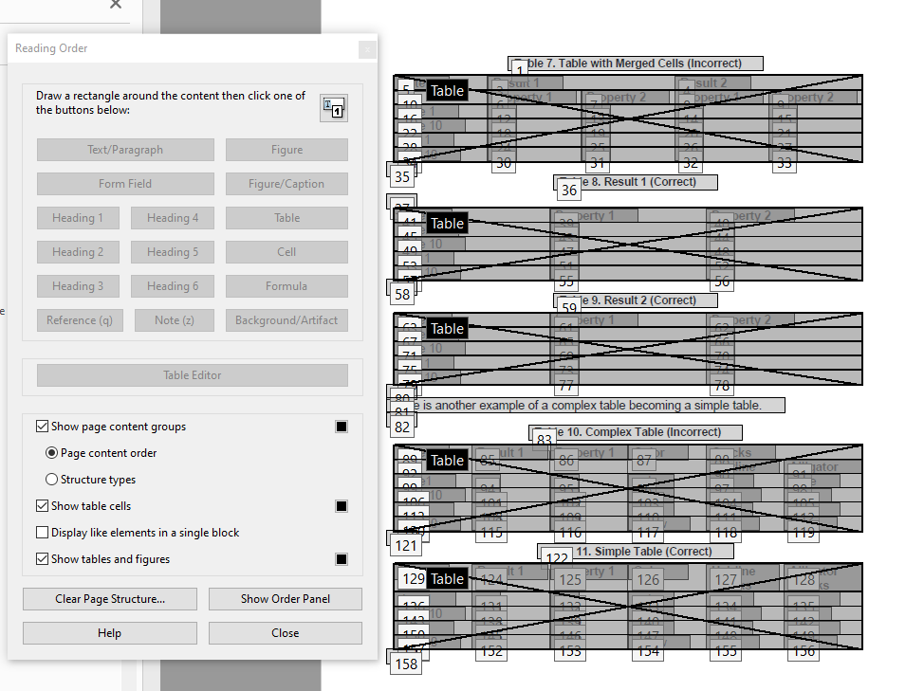
Everything seems to check out. How fortunate!
What happens when everything goes wrong?

Slide 24
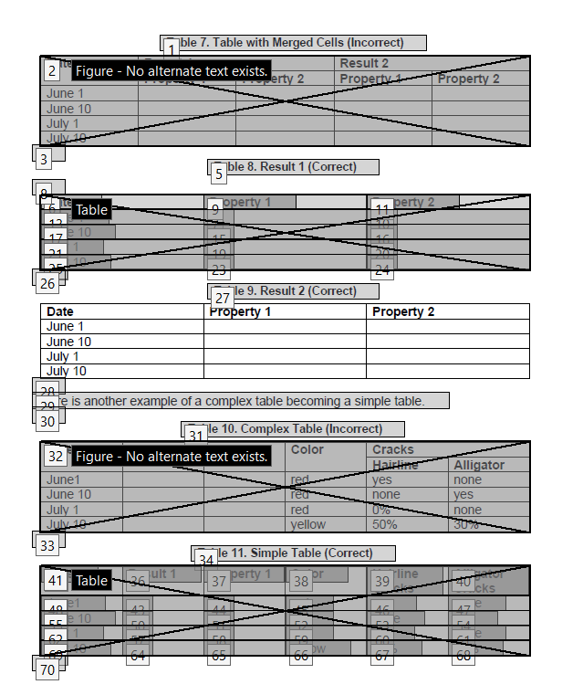
What all can you spot that is wrong with this page? Is any table correct?

Slide 25
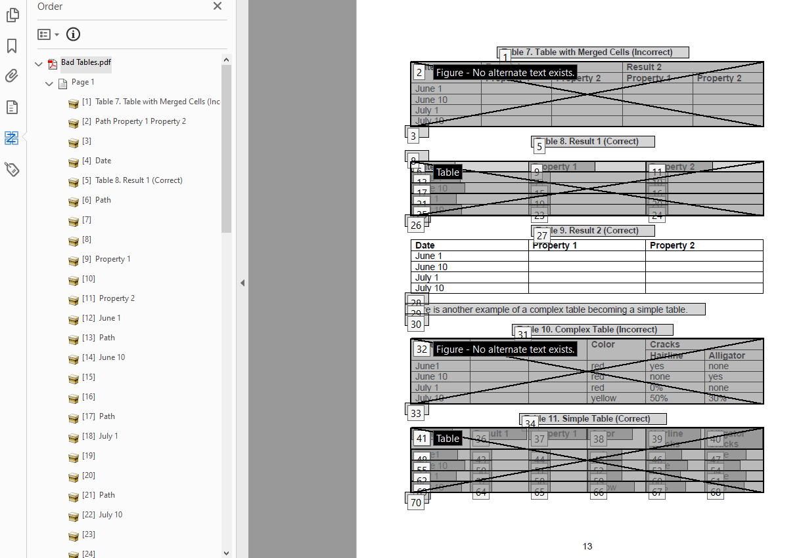
There are several ways to fix this.
Step 1: go into the order panel and manually drag incorrectly ordered items into the proper order

Slide 26
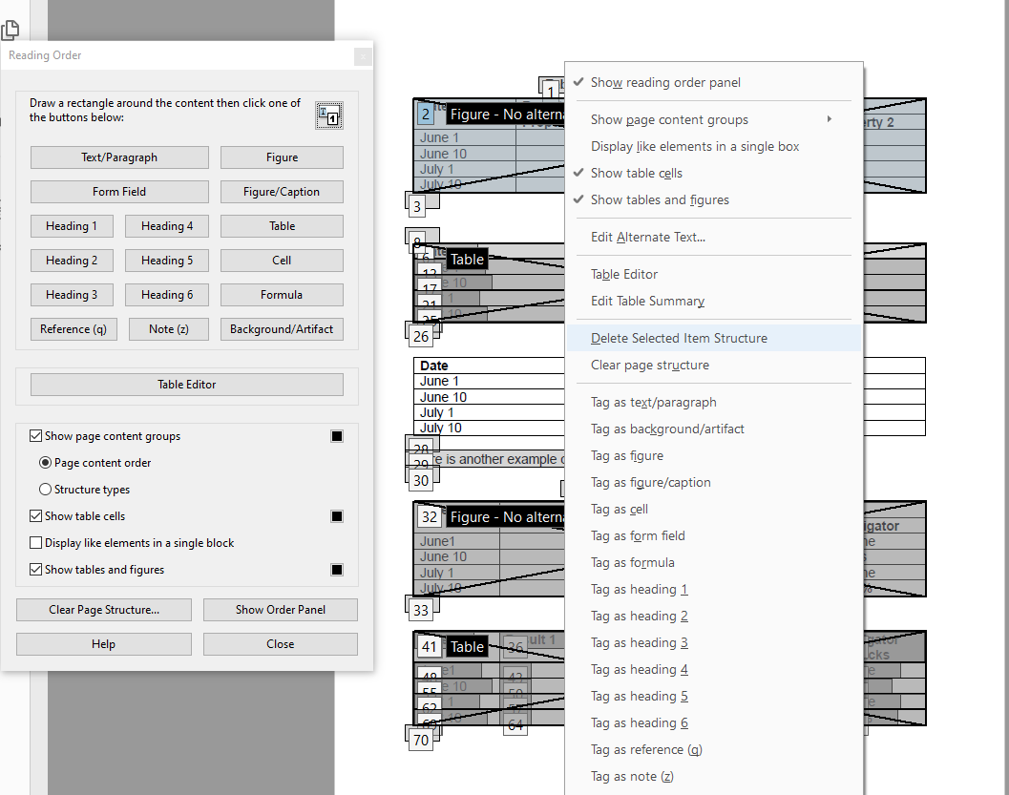
Step 2: Re-tag incorrectly tagged tables using the reading order tool.
To do this, select the incorrectly tagged table, right-click, and select “delete selected item structure.”

Slide 27
Step 3: Left-click and draw a rectangle around your table. When all of your table is highlighted in pink, select “Table” from the Reading Order tool to convert the selection to a table.
Table selection
Converted table

Slide 28
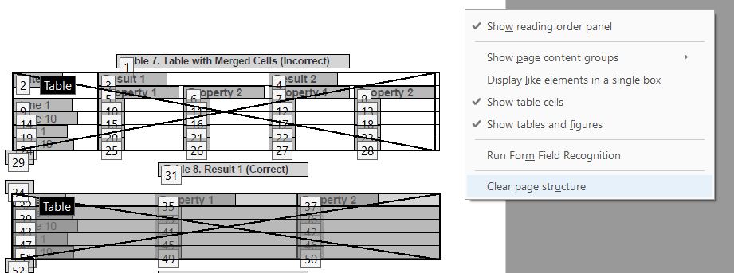
The Nuclear Option
Another way is to clear the entire page’s structure and rebuild from scratch.

Slide 29
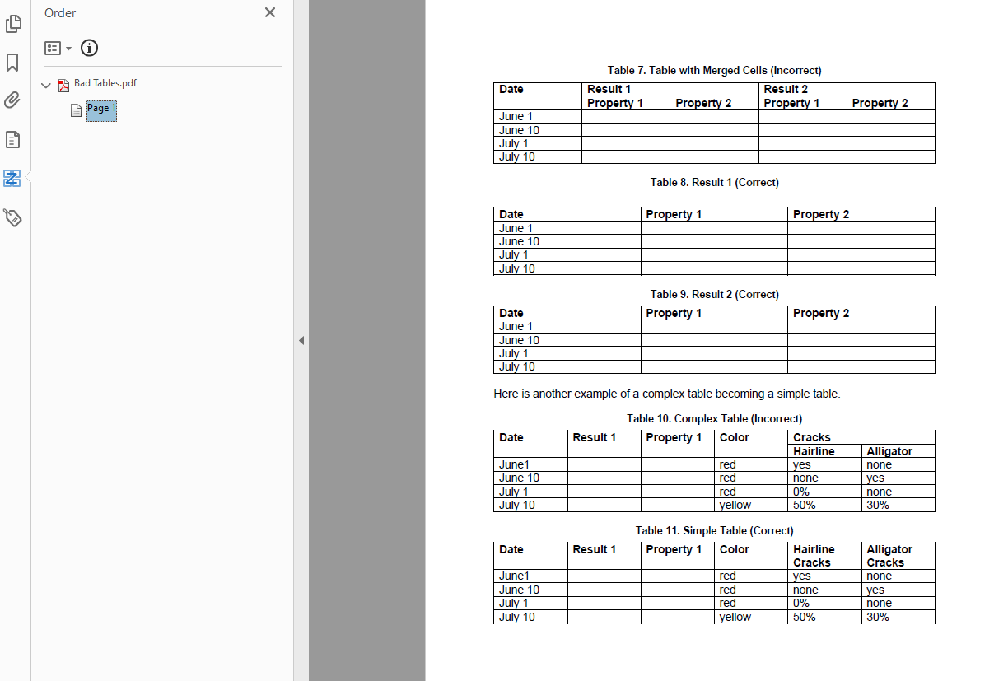
The Nuclear Option Cont.
As you can see, nothing is tagged. A screen reader will not be able to read anything.
The next step will be to select each item and tag it as text, or a table.

Slide 30
Workshopping Section
Questions, comments, or concerns? Are there tables you would like to have us work on?

